Slide 1
SPFx Community Call
Office locations –Adaptive Card Extension

Slide 2

Bio.tsx
return(
<div>
<img src=“ ”/>
<Name>Anoop Tatti</Name>
<Role>MVP, Developer</Role>
<Work>Content+Cloud</Work>
<Blog link=“https://anoopt.medium.com” />
<Twitter username=“anooptells” />
<GitHub username=“anoopt” />
</div>
);

Slide 3
Demo

Slide 4
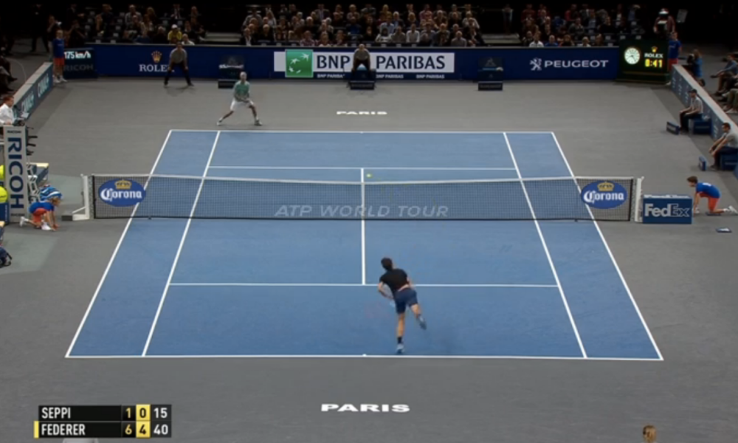
ACE
VIVA Connections
VIVA Connections

Slide 6
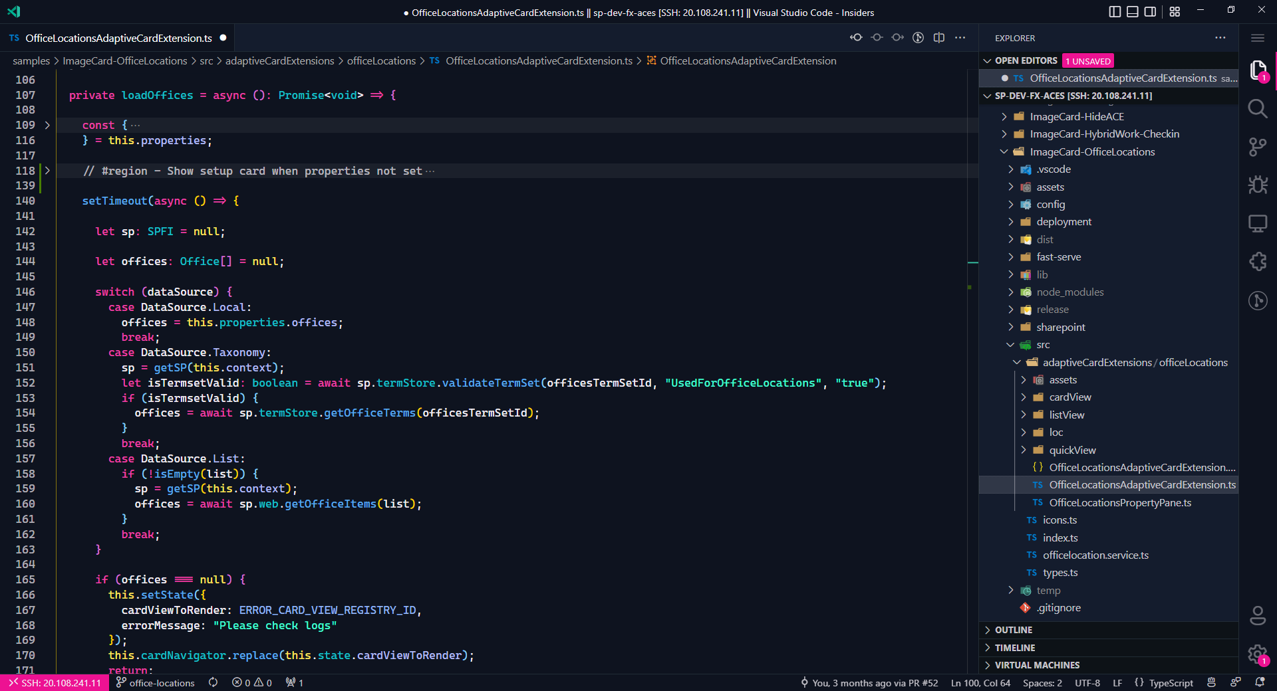

Slide 7
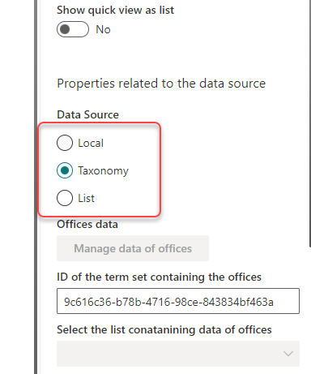

Slide 10
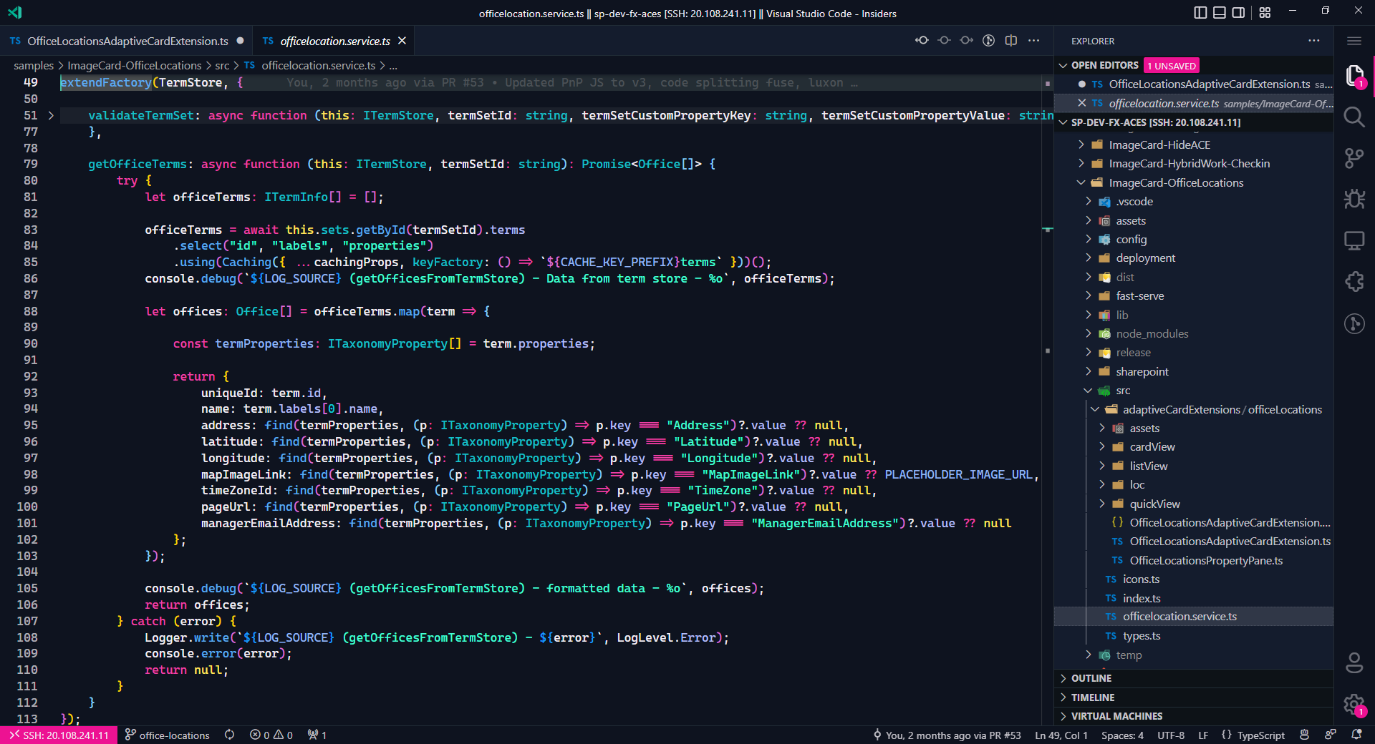

Slide 14
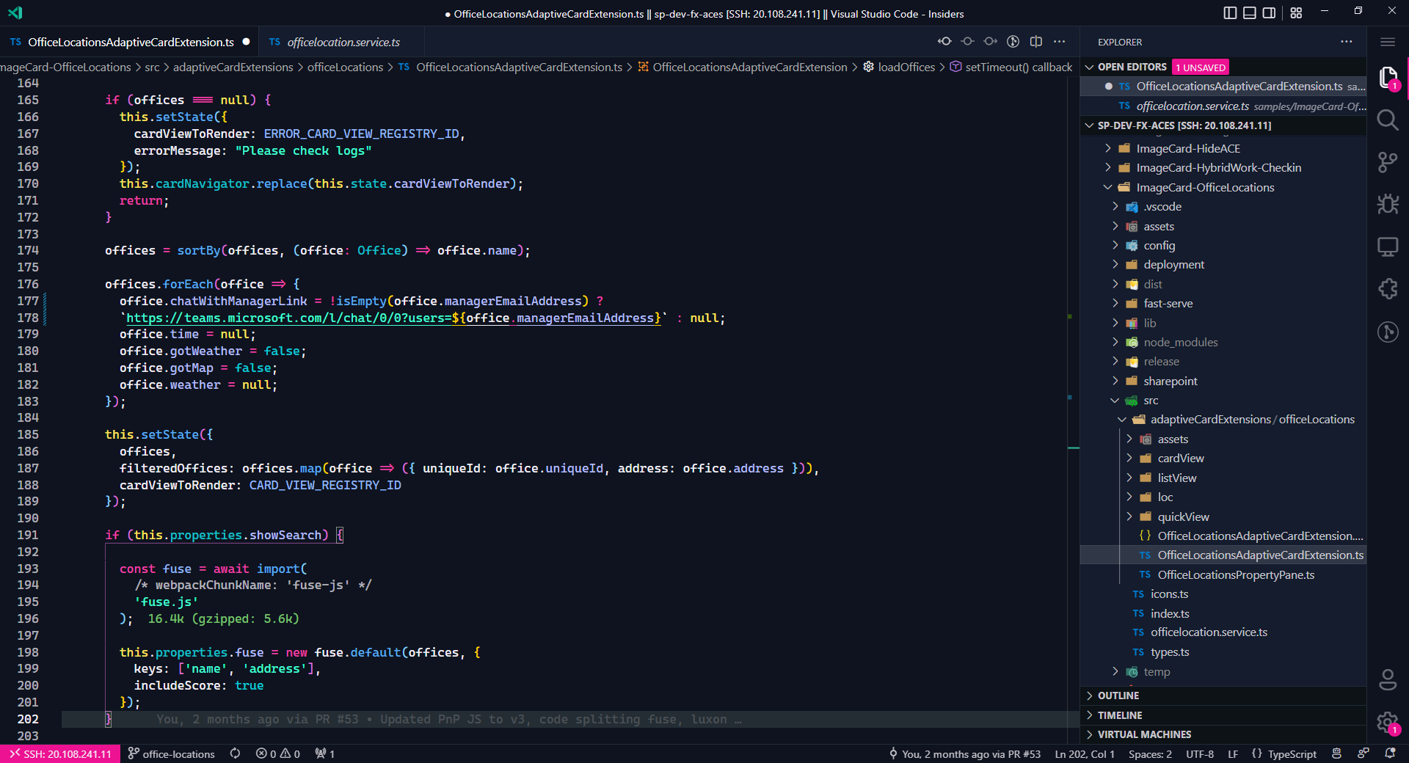

Slide 16
Status
Current
We have got the data related to offices from the term store
It is now present in the state – offices
Next steps
We now have to display
The number of offices
Each office in detail

Slide 18
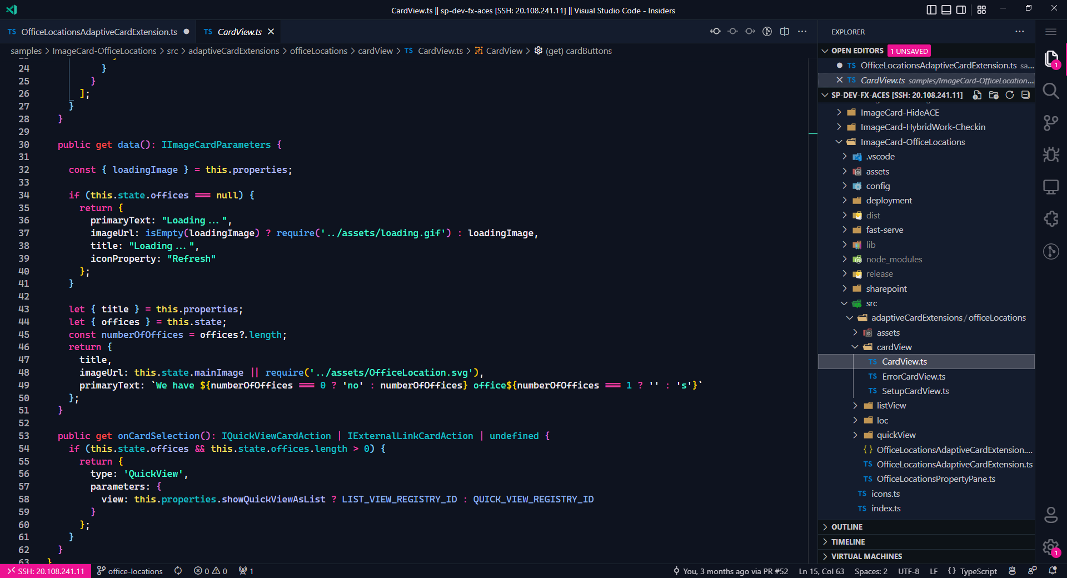
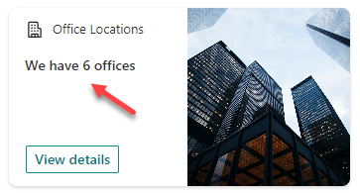

Slide 19
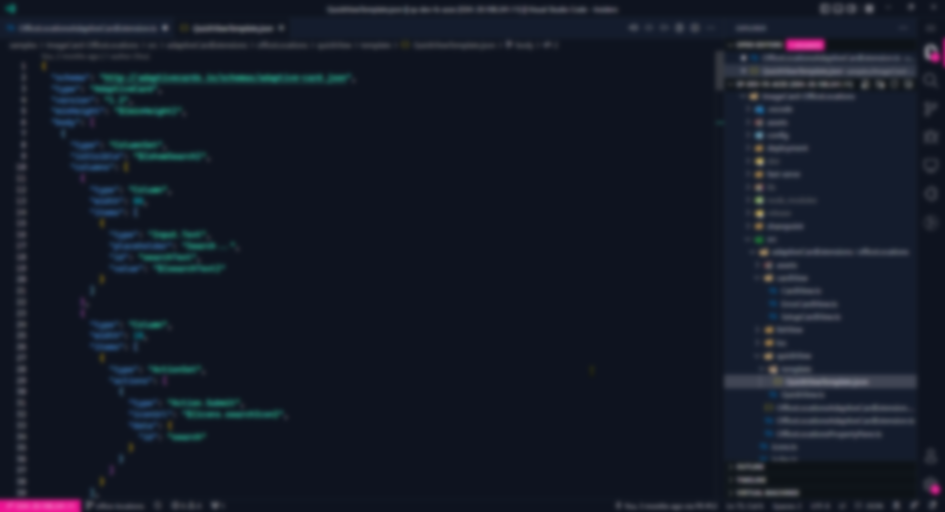
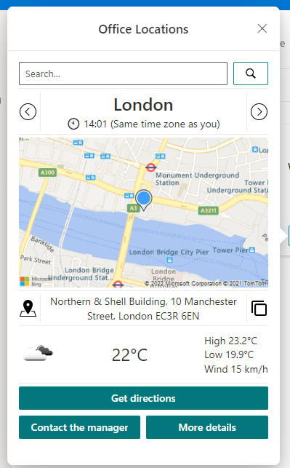

Slide 21
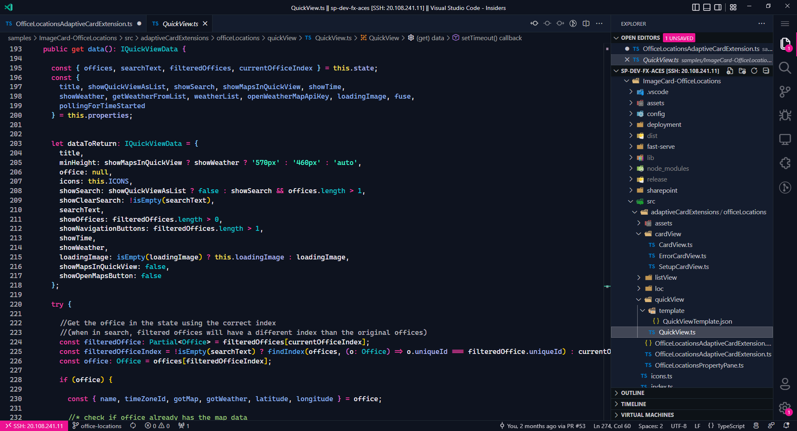

Slide 23
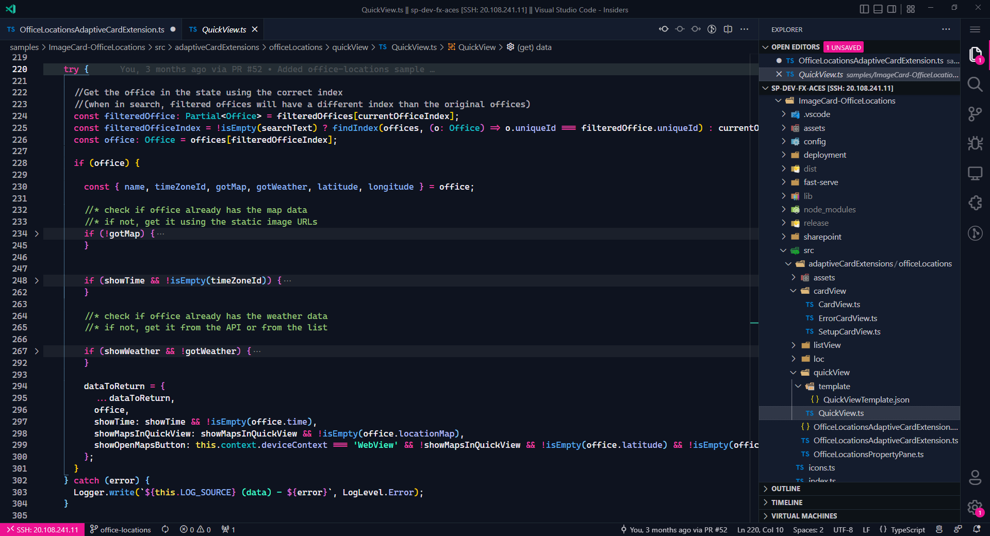

Slide 25
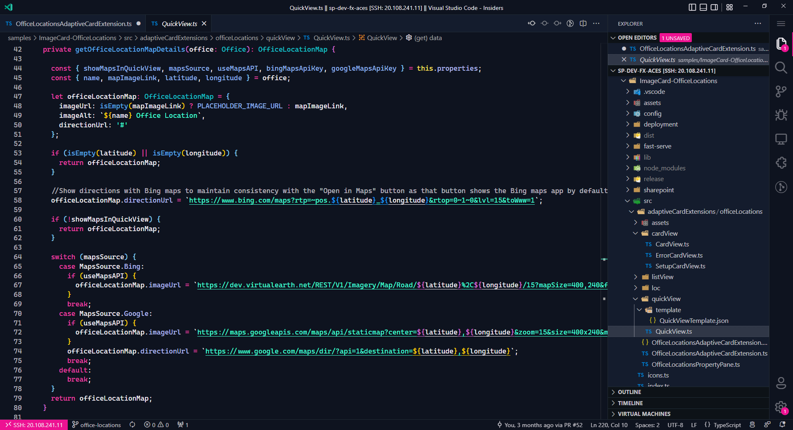

Slide 28
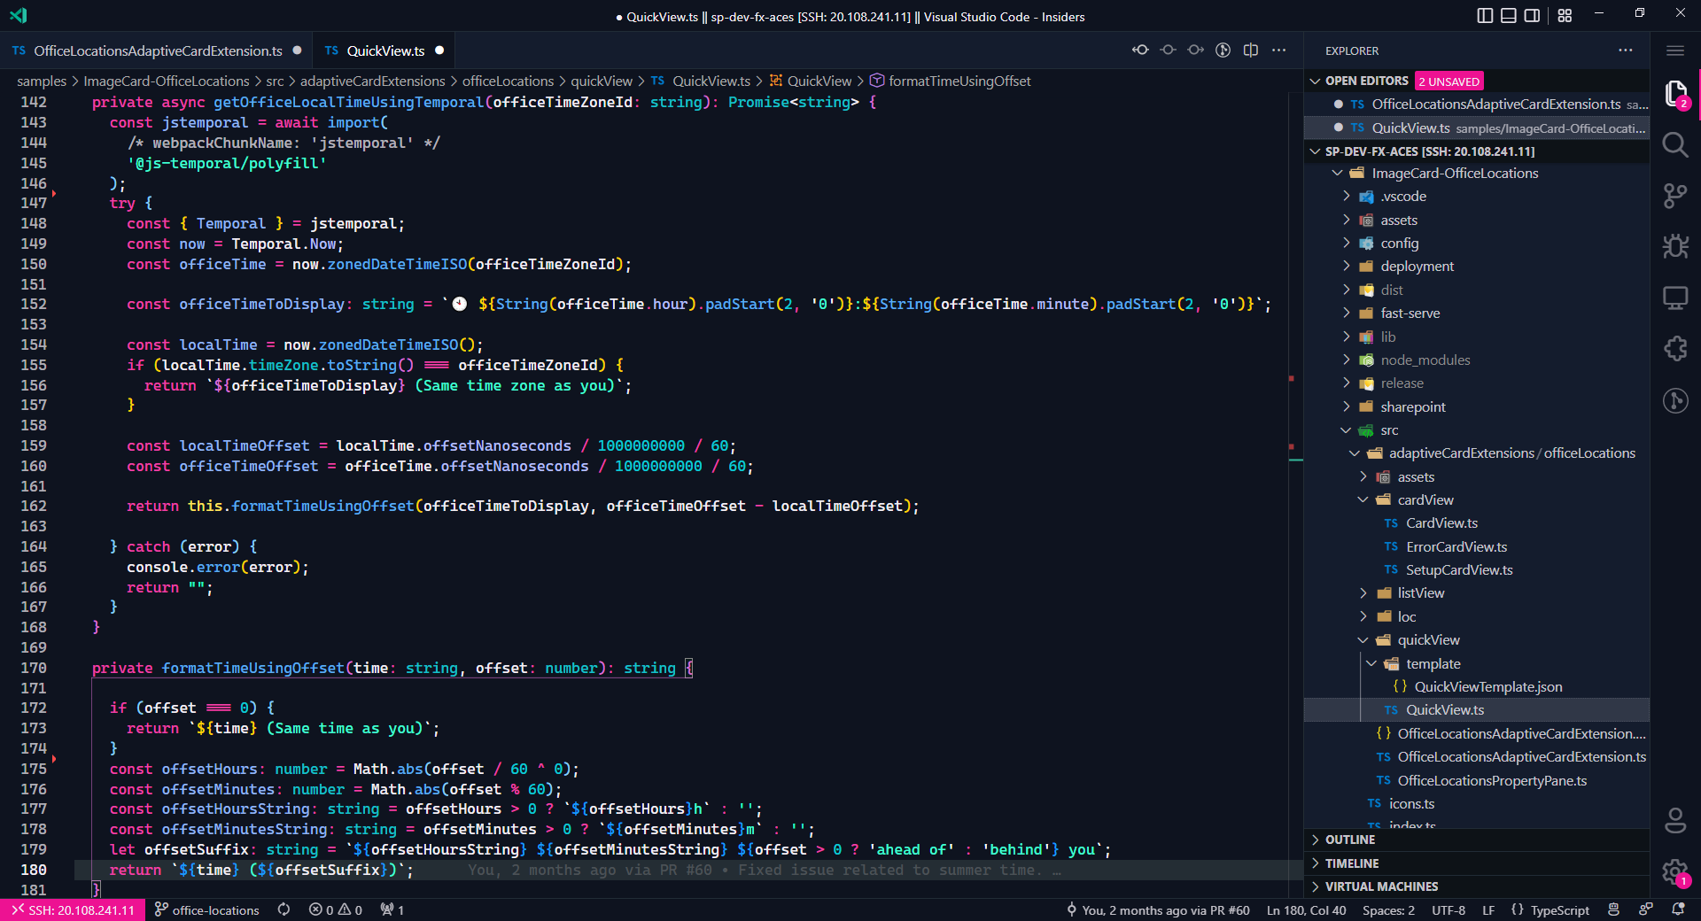

Slide 31
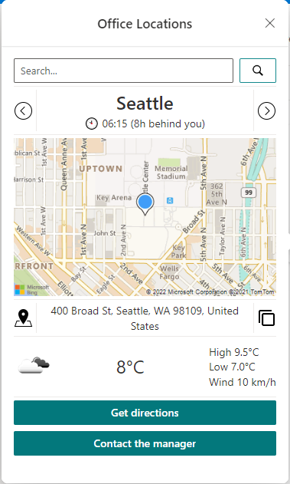

Slide 34
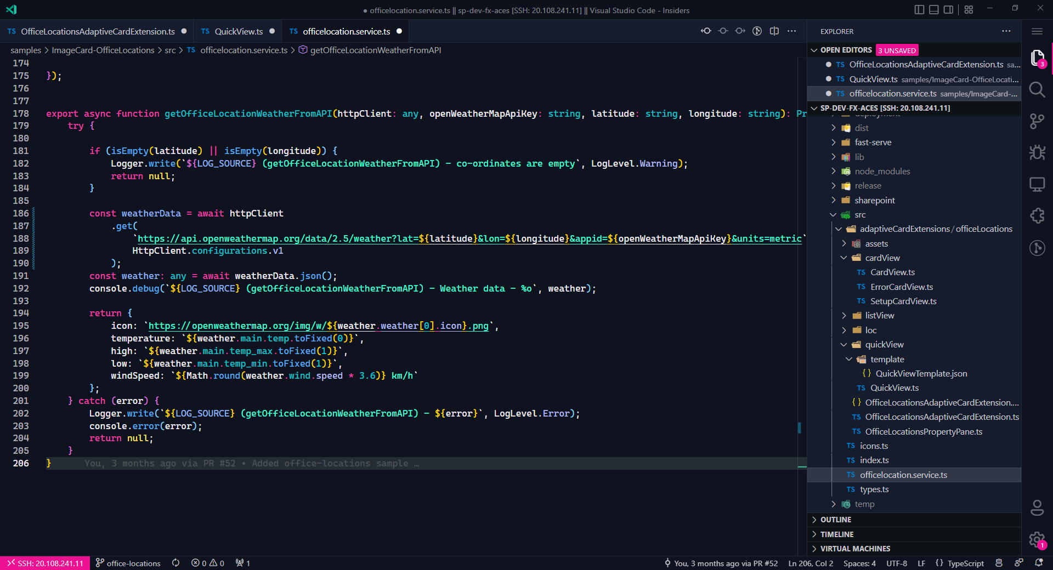

Slide 40
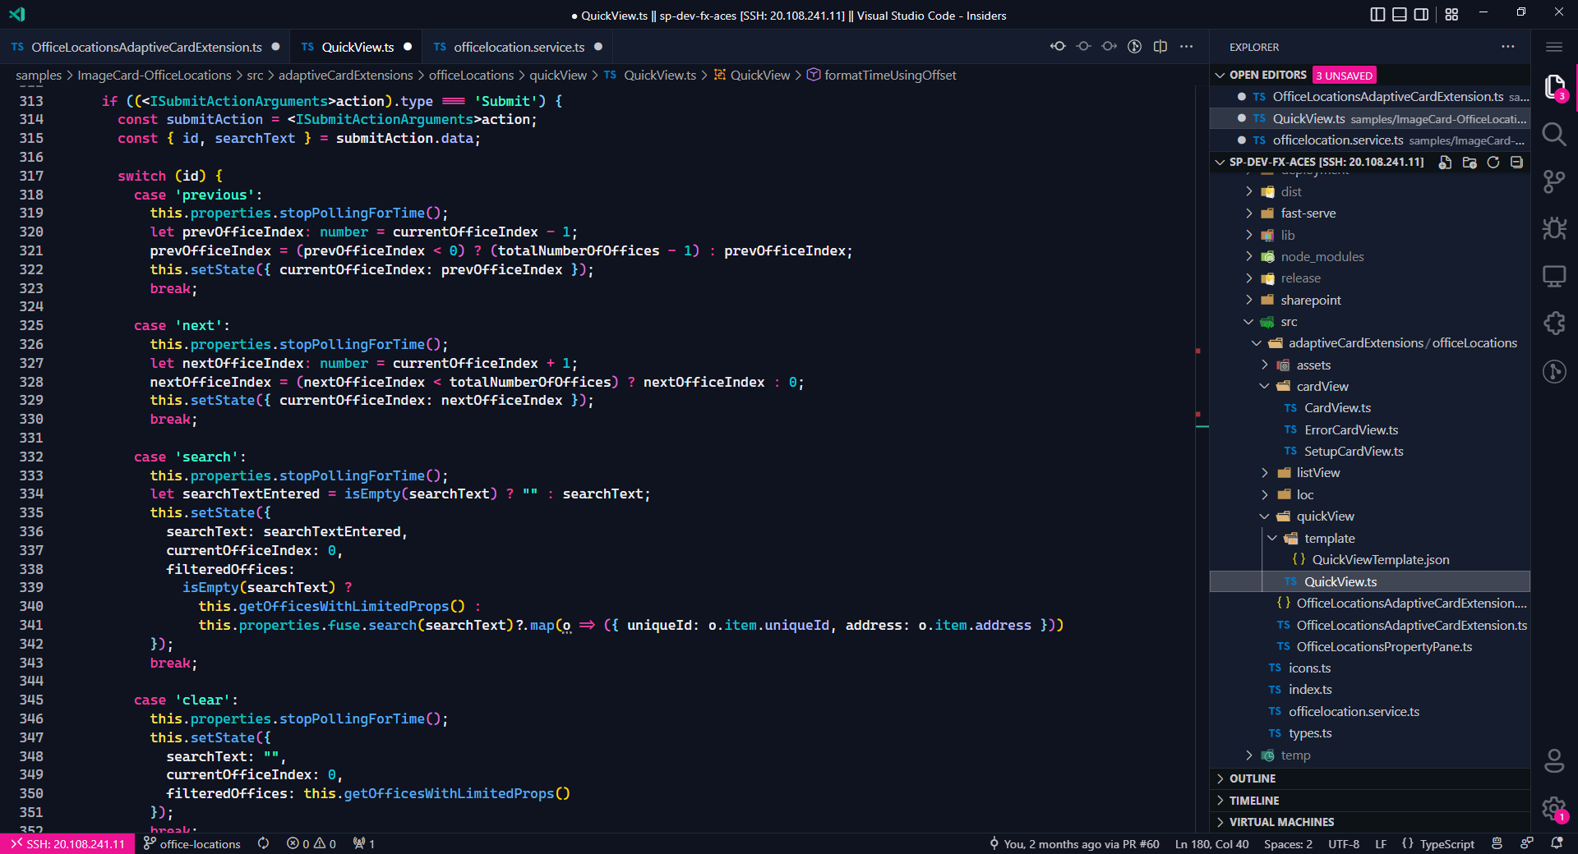

Slide 43
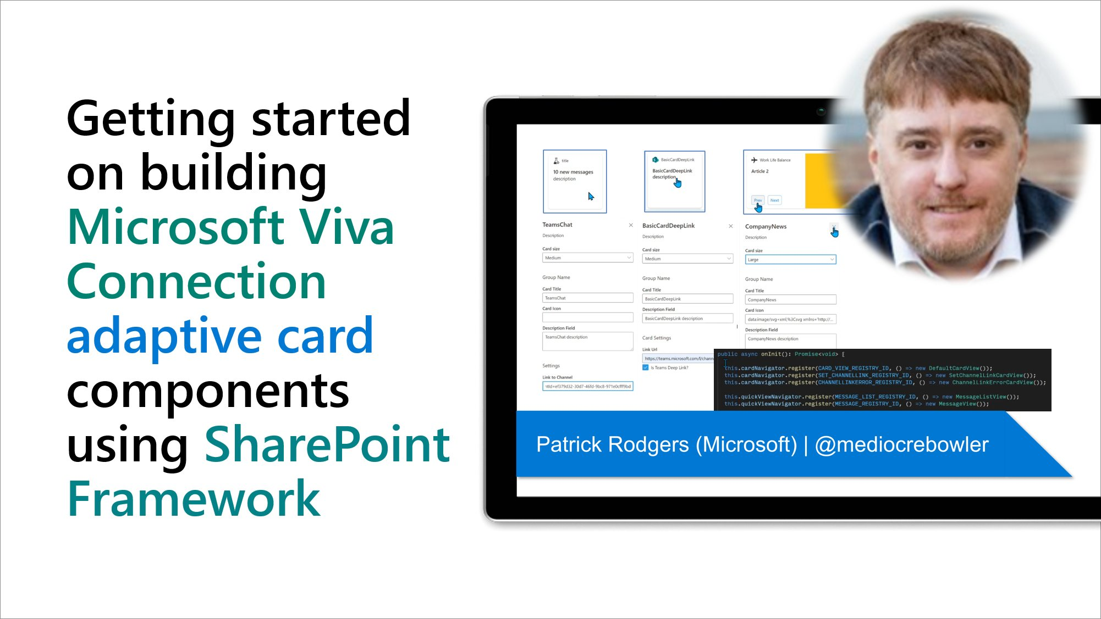
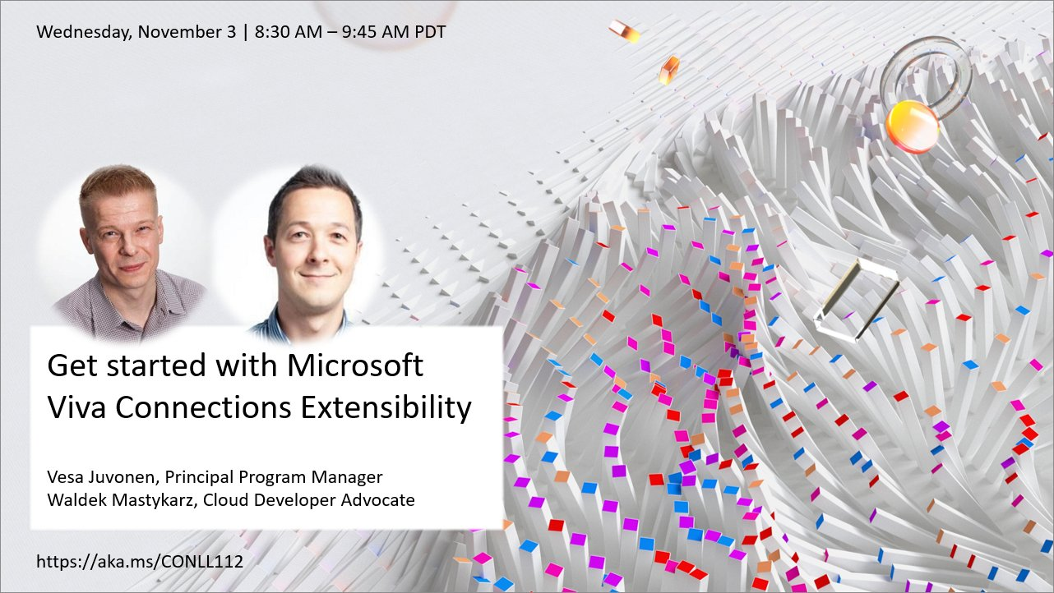
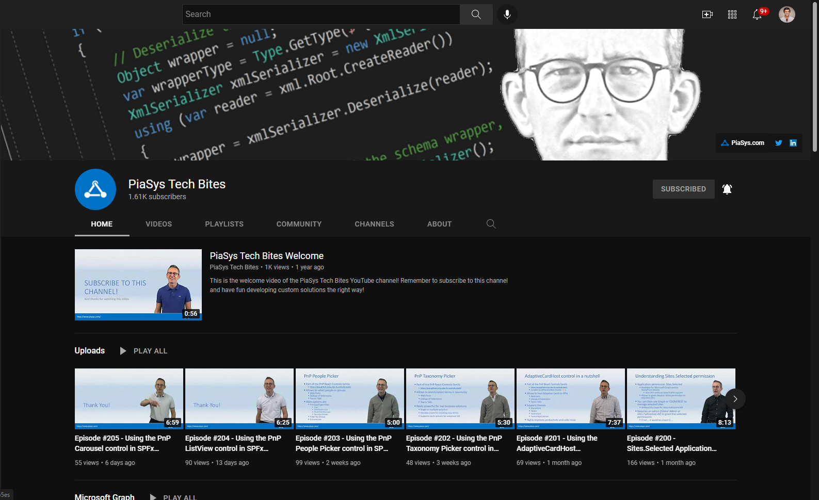
Building ACEs

Slide 44
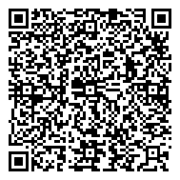
Resources
https://github.com/pnp/sp-dev-fx-aces/tree/main/samples/ImageCard-OfficeLocations
https://www.youtube.com/watch?v=KQGsY5fvLaY&ab_channel=Microsoft365Community
https://aka.ms/CONLL112
https://www.youtube.com/c/PiaSysTechBites

